Slide 1

International Data Spaces
Data Usage Control with the EDC
Julia Pampus
Dortmund, May 11TH, 2022

Slide 2
Agenda
Overview
Contract Management
Policy Enforcement
Outlook

Slide 3
Eclipse dataspace Connector
overview

Slide 4
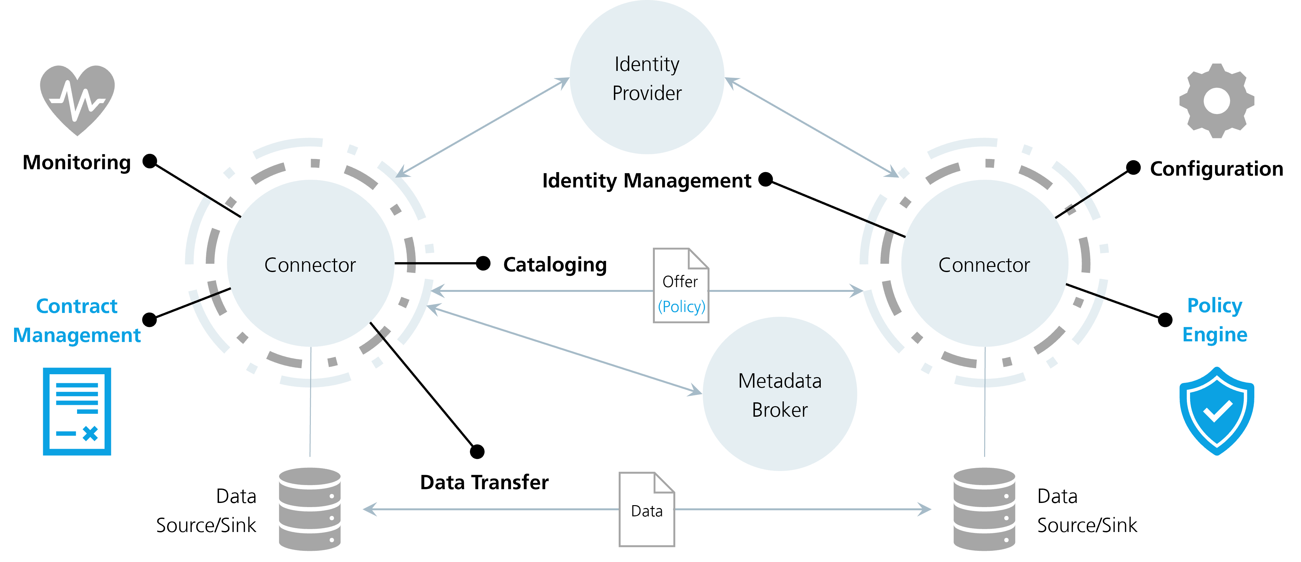
Technical Capabilities

Slide 5
Design Principles
Separation of information flows (control) and data transfer (exchange)
Asynchro-nous and highly available
Modular and extensible
System security (using e.g. vaults and encryption)
Cloud-aware policy enforcement
Fully auditable processes

Slide 6
Eclipse dataspace Connector
Contract management

Slide 7
Communication Process
Provide Offer
Initiate Contract Negotiation
Negotiation Phase
Agreement
Data Transfer
Define asset
Validate contract and policies
Agree on policy
Transfer data (via IDS or out-of-band)
Create contract definition with policies
Make offer available
Create request (adopt or new)
Interception by systems/users
Sign contract
Persist contract
Optionally involve 3rd party
Enforce policies of agreement
Select protocol (e.g., IDS)

Slide 8
Domain model
Contract Definition
Contract Offer
Contract Negotiation
Template for
contract offers
generates
Dynamically generated and not persisted
contains
Represents
negotiation process
selects
contains
converted to
generates
Asset
Policy
Contract Agreement
Describes data that should be transferred
Technically processable (based on ODRL)
Signed contract between data provider and consumer
https://github.com/eclipse-dataspaceconnector/DataSpaceConnector/blob/main/docs/domain-model.md (accessed: 20.04.2022)

Slide 9
Contract Definition
Unique Identifier
Access Policy
Not part of the data/contract offer
Used for implementing access control on metadata level
Represents the same structure as a contract policy
E.g., this may require another connector to be in a business partner tier
Non-public requirements for accessing a set of assets
Contract Policy
Defines the requirements a data consumer must follow when using (e.g., processing) the data
Advertised to other connectors as part of a contract
The final contract is agreed upon during a negotiation process
Follows the structure of ODRL: target, assigner, assignee, rules, constraints, etc.
Data usage and
access policies
Asset Selector

Slide 10
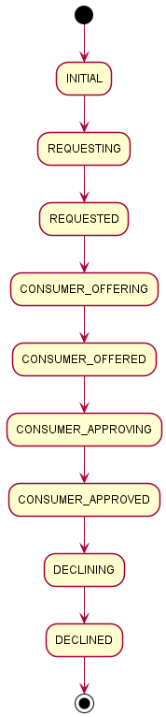
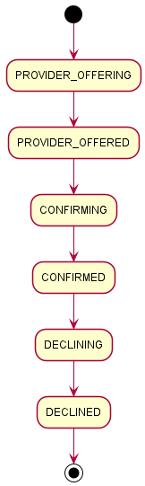
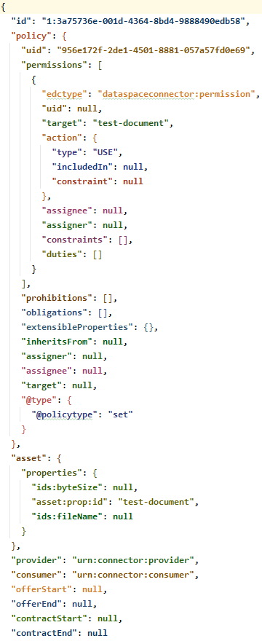
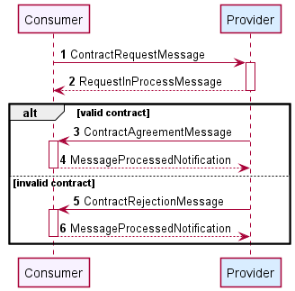
Contract Negotiation
State machine architecture (asynchronous processing)
Protocol: IDS multipart
Following the sequences defined in RAM v4.0

Slide 11
Eclipse dataspace Connector
Policy enforcement

Slide 12

interfaces

Slide 13
DSC vs. EDC
Dataspace Connector
Fixed implementation (and interpretation) of selected IDS usage control classes
Restriction: data cannot leave the connector
Eclipse Dataspace Connector
Modular implementation
Policy engine with fixed interfaces
Supported policies depend on the deployment/setup/extensions
Easily replaceable and expandable
https://international-data-spaces-association.github.io/DataspaceConnector/Documentation/v6/UsageControl (accessed: 09.05.2022)

Slide 14
policy scopes
Definition
Assumption 1: Policy rules may only be applicable in certain runtime contexts.
Example: “Data must be anonymized.”
May be applicable to policy evaluation when a resource is provisioned
May not be applicable during data transfer
Assumption 2: Policy rules may have different implementation semantics in certain runtime contexts.
Example: “Data must remain in EU-based compute environments.”
When this rule is evaluated during authorization, a verifiable credential may be checked.
When data transfer occurs, this rule may require data to be stored in a particular cloud region.
Policy Scopes = runtime visibility and semantic boundaries for policy rules
Hierarchical and expressed using dot notation (e.g., “provision.verify”)
If a rule is visible in a given scope, it will be included in policy evaluations for that scope; otherwise, it will be omitted.
Rule Binding = makes a rule type visible in a policy scope

Slide 15
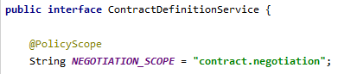
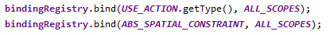
Policy Scopes
Application
Define policy scope in service extension
Add RuleBindingRegistry to ServiceExtensionContext
Bind policy with scope
During execution: ScopeFilter filters a policy for a scope. This involves recursively removing rules and constraints not bound to the scope and returning a modified copy of the unfiltered policy. (applicable to policy, permission, duty, prohibition, condition)

Slide 16
Eclipse dataspace Connector
Outlook

Slide 17
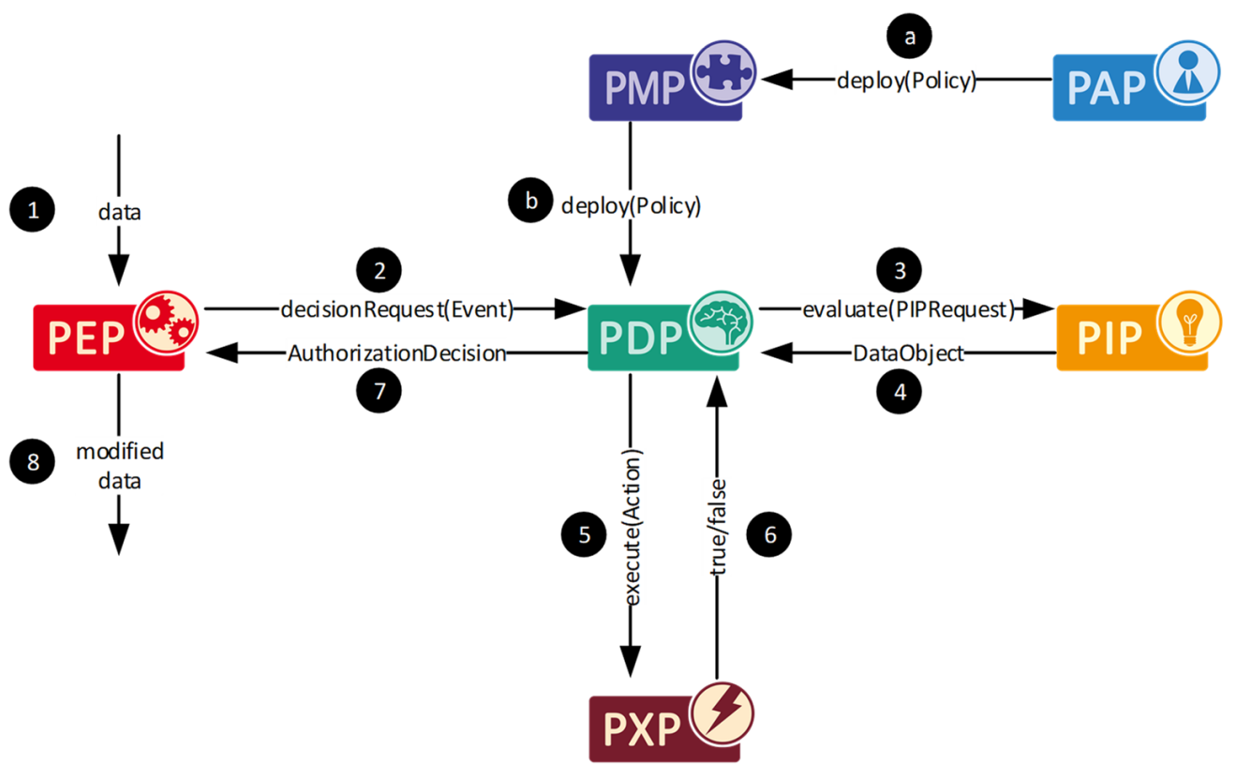
Next steps
Design policy engine, perhaps oriented towards
eXtensible Access Control Markup Language (XACML)
and its interpretation and extension by IDS
Implement policy enforcement for selected attributes
Discussion points
What kinds of policy need to be supported?
How to connect standardized interfaces and use external tools (e.g., OPA)?
How to provide standardized interfaces for extensions?
How to ensure policy enforcement for data that leaves the connector?

Slide 18
Events
2nd Gaia-X Hackathon (12/2021)
Bringing Usage Control (UCON+) into the EDC
Provide extension (EDC-UCS) that extends the default policy behavior of the EDC
Add custom PEPs and obligations for two samples (file transfer, streaming): anonymize e-mail address with a regex
More information here
3rd Gaia-X Hackathon (03/2022)
Understand the mapping between the ODRL and XACML models
Implement a PoC that outputs ALFA policies based on ODRL policies
Demonstrate this with the EDC-UCON integration results from the previous hackathon
More information here
Contributions from German Research Center, Huawei Technologies (Munich) and Security Forge (Pisa)

Slide 19
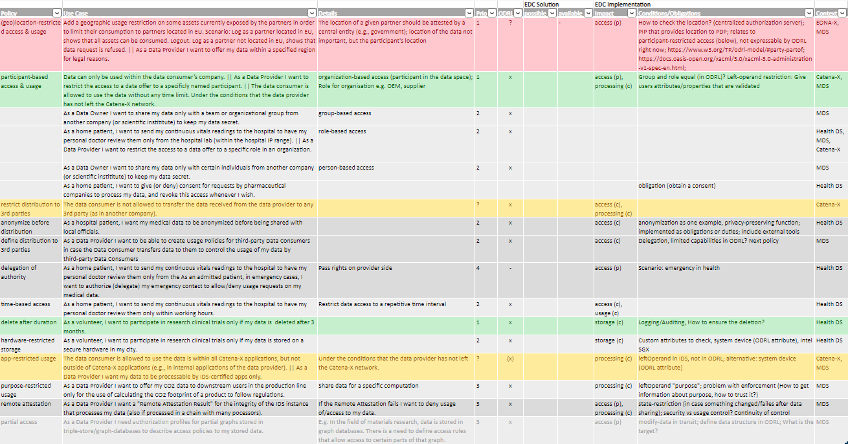
Workshop
https://github.com/eclipse-dataspaceconnector/Collateral/tree/main/Work Content/Usage Control (accessed: 06.05.2022)

Slide 20
Join the discussion on github
Issues and discussions
https://github.com/eclipse-dataspaceconnector/DataSpaceConnector/discussions/878
https://github.com/eclipse-dataspaceconnector/DataSpaceConnector/discussions/1229
https://github.com/eclipse-dataspaceconnector/DataSpaceConnector/discussions/792
https://github.com/eclipse-dataspaceconnector/DataSpaceConnector/discussions/447
https://github.com/eclipse-dataspaceconnector/DataSpaceConnector/discussions/742
https://github.com/eclipse-dataspaceconnector/DataSpaceConnector/issues/857
Existing documentation
https://github.com/eclipse-dataspaceconnector/DataSpaceConnector/blob/main/docs/Policies.md
https://github.com/eclipse-dataspaceconnector/DataSpaceConnector/blob/main/docs/domain-model.md
https://github.com/eclipse-dataspaceconnector/DataSpaceConnector/blob/main/docs/architecture/contracts.md
https://github.com/eclipse-dataspaceconnector/DataSpaceConnector/tree/main/docs/developer/decision-records/2022-03-15-policy-scopes

Slide 21



!
Julia Pampus
RESEARCH Associate
Department Data BUSINESS
Julia.pampus@isst.fraunhofer.de
+49 231 97677 429
Fraunhofer ISST
Emil-Figge-Str. 91
44227 Dortmund | Germany
Join us
@ids_association
# internationaldataspaces

